Slide 1
Faith Celebration Fellowship
Get Rooted, Get Solid Discipleship
Welcome to Module 2!
January 16, 2014

Slide 2
BATTING BASE:
START: SPIRITUAL BIRTH:
Knowing Christ; Infant Stage
MODULE 2:
BASIC BIBLE TEACHINGS 1
LESSON 1: BIBLE

Slide 3
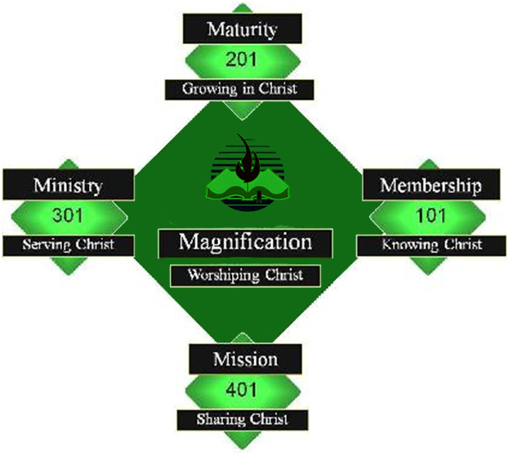

Slide 4
PROVING THE BIBLE
2 Peter 3:16
2 Peter 1:16
Hebrews 1:1,2

Slide 5
Batting Base: Start: Spiritual Birth
Knowing Christ
Infant Stage
New Life Lessons
Basis Bible Teachings I
Basic Bible Teachings 2

Slide 6
2nd BASE: MATURITY
Growing with Christ
Teen Age
Fruit of the Spirit
Growing Isssues
Theology

Slide 7
IV. 3rd BASE: MINISTRY
Serving Christ
Young Adult Stage
Equipping for ministry lessons
Victorious minister
Bible Overview

Slide 8
V. 4th BASE: MISSION
Sharing Christ
Parenthood Stage
Disciples’ Mission
Life and Teachings of Jesus
21 Laws of Leadership or
Life and Teachings of Jesus 2

Slide 9
2 Timothy 3:16
¹⁶ All Scripture is God-breathed and is useful for teaching, rebuking, correcting and training in righteousness

Slide 10
2 Peter 1:16
¹⁶ We did not follow cleverly invented stories when we told you about the power and coming of our Lord Jesus Christ, but we were eyewitnesses of his majesty.

Slide 11
Hebrews 1:1-2
1 In the past God spoke to our forefathers through the prophets at many times and in various ways, ² but in these last days he has spoken to us by his Son, whom he appointed heir of all things, and through whom he made the universe.

Slide 12
B: BIBLIOGRAPHY
B. The Time Span Between Manuscripts
1. Plato’s Tetralogies
a. Written: 400 BC
b. Earliest extant copies: 900 AD
c. Span: Nearly 1300 years

Slide 13
B: BIBLIOGRAPHY
2. Caesar’s Gallic Wars
a. Written: 60 BC
b. Earliest copies: 900 AD
c. Span: Nearly 1000 years

Slide 14
B: BIBLIOGRAPHY
3. Homer’s Iliad
a. Written: 900 BC
b. Earliest manuscript: 400 BC
c. Span: About 500 years

Slide 15
B: BIBLIOGRAPHY
4. New Testament
a. Written: No later than 100 AD
b. Earliest copy: No later than 200 AD
c. Span: About 100 years

Slide 16
I. INTERNAL HARMONY OR CONSISTENCY
A. Harmony and Consistency from Differences
1. Different books: 66
2. Different authors: Approximately 40
3. Different era: Time span of writings: approximately 1600 years
4. Different languages: Hebrew, Aramaic, Greek
5. Different subjects

Slide 17
I. INTERNAL HARMONY OR
CONSISTENCY
B. Harmony and Consistency from Similarities
1. Topics: God, Man, Redemption: Christ, Kingdom of God
2. History: From beginning
To culmination

Slide 18
III. B: BIBLE PROPHECY
A. Fulfilled Prophecies
Examples:
What city he would be born in

Slide 19
Micah 5:2
² “But you, Bethlehem Ephrathah, though you are small among the clans^{[a]} of Judah, out of you will come for me one who will be ruler over Israel, whose origins^{[b]} are from of old, from ancient times.^{[c]}”

Slide 20
How He would be born of a virgin
Isaiah 7:14
¹⁴ Therefore the Lord himself will give you a sign: The virgin will be with child and will give birth to a son, and will call him Immanuel.

Slide 21
Exact time of the Messiah
Daniel 9:25 (KJV)
²⁵ Know therefore and understand, that from the going forth of the commandment to restore and to build Jerusalem unto the Messiah the Prince shall be seven weeks, and threescore and two weeks: the street shall be built again, and the wall, even in troublous times.

Slide 22
Quote: “How long are the years? Mankind has used hundreds of different ways to calculate the passing of the years, and all of them are different. To calculate this prophecy we need to turn to the Bible and find out how the biblical prophetic calendar was laid out. From Genesis 7:11,24, 8:3-4, Revelation 12:6,14 and other texts we know that the Bible uses a simple calendar of 360 days per year.

Slide 23
With this in mind we can be more precise and find out the exact day that the Messiah was predicted to come. 360 days times 69 years gives us 173,880 days. If we add that number to March 14, 445BC we come to April 6, 32AD. This calculation has been verified by many unbiased sources including the British Royal Observatory of Greenwich, England.” http://www.redmoonrising.com/daniel.htm

Slide 24
How He would suffer and die:
See Isaiah 53

Slide 25
Exact time when He would die
Daniel 9:26 (KJV) ²⁶ And after threescore and two weeks shall Messiah be cut off, but not for himself: and the people of the prince that shall come shall destroy the city and the sanctuary; and the end thereof shall be with a flood, and unto the end of the war desolations are determined.

Slide 26
B. Probability of Prophecies
1. Mathematical odds of 8 prophecies coming true to one person in all history
1 chance in 10 to the 17th power
2. Mathematical odds of 48 prophecies
1 chance in 10 to the 157th power

Slide 27
LORD’S VIEW
A. He Put the Stamp of Approval on the OT
Luke 24:44
⁴⁴ He said to them, “This is what I told you while I was still with you: Everything must be fulfilled that is written about me in the Law of Moses, the Prophets and the Psalms.”

Slide 28
LORD’S VIEW
B. He Declared the Eternality of His Words
Matthew 24:35 (KJV) ³⁵ Heaven and earth shall pass away, but my words shall not pass away.

Slide 29
LORD’S VIEW
B. He Declared the Eternality of His Words
John 14:26 (KJV)
²⁶ But the Comforter, which is the Holy Ghost, whom the Father will send in my name, he shall teach you all things, and bring all things to your remembrance, whatsoever I have said unto you.

Slide 30
E. EXTERNAL EVIDENCE
A. Archaeological Findings
Examples:
Taylor prism
Tablet Number 11 of the Epic of Gilgamesh

Slide 31
E. EXTERNAL EVIDENCE
B. Extra-Biblical Writings
Roman Historian Tacitus
Jewish Writer Josephus

Slide 32
Suggested memory verses:
Matthew 24:35 (KJV) ³⁵ Heaven and earth shall pass away, but my words shall not pass away.

Slide 33
Suggested memory verses:
John 14:26 (KJV)
²⁶ But the Comforter, which is the Holy Ghost, whom the Father will send in my name, he shall teach you all things, and bring all things to your remembrance, whatsoever I have said unto you.

Slide 34
Actions Steps for the Entire Module
Read:
The Reason for God by Timothy Keller
How Good is Good Enough? by Andy Stanley
Welcome to the Revolution: A Field Guide for New Believers by Brian Tome
Watch:
How Great is Our God by Louie Giglio

